Slide 1

INTELLECTUAL PROPERTY RIGHTS MODULE 5
Module 5

Slide 2

INTELLECTUAL PROPERTY
Intellectual property refers to any intellectual creation like by application of human intellect.
It is referred as as “Bauddhik sampada” in the indian context.
‘Bauddhik’ means related to buddhi or intellect.
‘sampada’ means property.
The owner of Intellectual property is provided a bundle of rights related to the property.
These rights collectively are termed as intellectual Property rights.

Slide 3

Intellectual property rights protect the interests of creators by giving them property rights over their creations.
TRIPS came into effect on 1 January 1995.
The areas of intellectual property that it covers are Copyright, Trademarks, Geographical indications, Industrial designs and Patent.
The Agreement on Trade-Related Aspects of Intellectual Property Rights (TRIPS) is an international treaty administered by the World Trade Organization (WTO).
TRIPS sets out minimum standards for the protection of various forms of intellectual property (IP) among member countries.

Slide 4

INTELLECTUAL PROPERTY UNDER TRIPS
Main categories of intellectual properties under TRIPS.
PATENT
COPYRIGHT
TRADEMARK
INDUSTRIAL DESIGN
GEOGRAPHICAL INDICATIONS

Slide 5
DESIGN REGISTRATION
Registration of a Design helps in protecting the products which can be distinguished by their novel shape or pattern.
Registration provides the owner exclusive rights to use the design.
The aesthetic design or appearance of industrial products that makes products look good or different can be protected using design registration.
Example:
The shape of a product: The shape of a Coca-Cola bottle, The shape of a Samsung Galaxy phone
The pattern on a product: The pattern on a Nike sneaker
The color scheme of a product: The color scheme of a Starbucks coffee cup

Slide 6
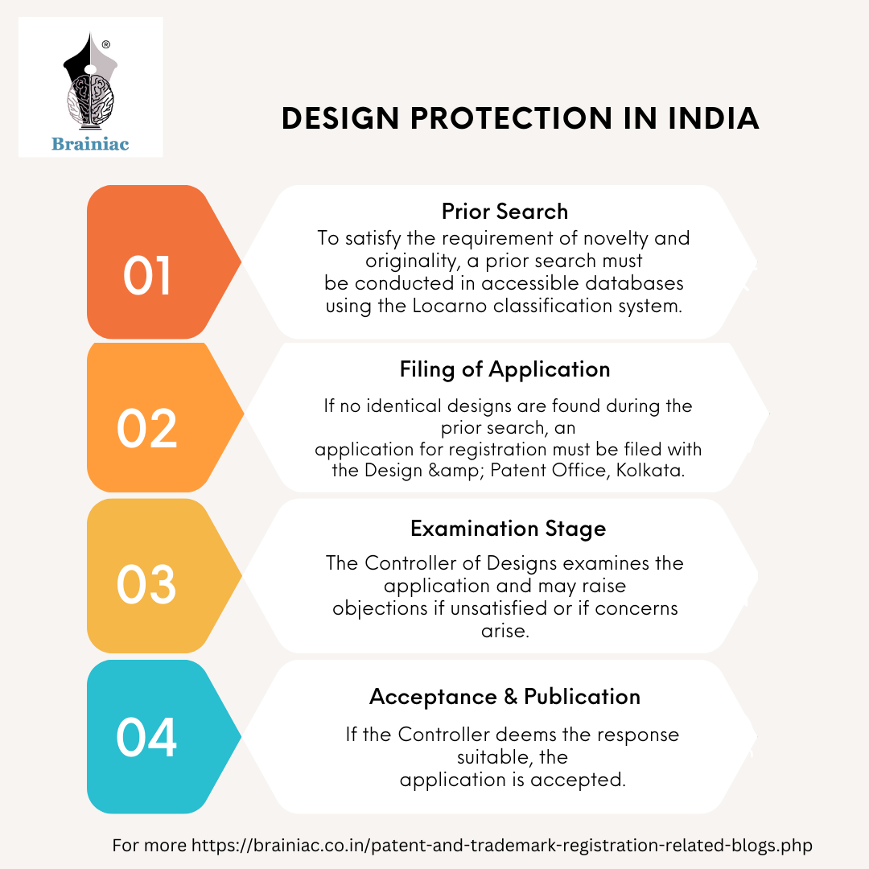
DESIGN REGISTRATION PROCESS

Slide 7
PATENT
Patents grant protection to certain new products, processes, apparatus, or any other technical inventions.
The property should not be disclosed anywhere in the world at the time of the application for patent.
Patent is expensive in terms of time, money and effort.
Patents need to describe in detail the technical aspects of the product.
Registration of patent provides its owner the right to prevent others from making, using, selling, or importing the inventions.
Patent Validity is for 20 years from the date of grant of patent.

Slide 8

PATENT
Any invention that involves utility can be patented.
Any design that improves the functionality of the product can also be patented.
Examples:
New inventions: The light bulb, the telephone, the computer.
New processes: The manufacturing process for a new drug, the method for creating a new type of solar cell.
New designs: The design of a new car, the design of a new computer

Slide 9


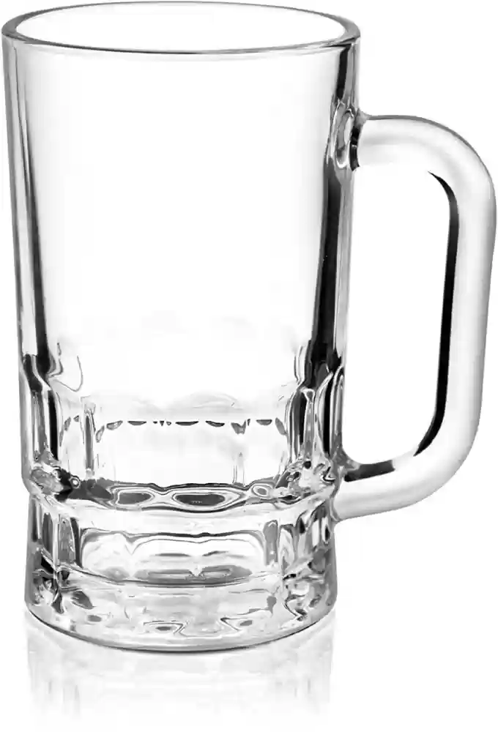
DESIGN REGISTRATION / PATENT FILING ?

Slide 10
DESIGN
PATENT
GLASS 2 : No change in functionality , only the aesthetic appearance of the glass is changed, makes it look good.
GLASS 3 : It includes a handle, thus adding a functionality to the product. Improves the utility.

Slide 11
PATENT FILING PROCEDURE
Preparation of Invention Disclosure: Prepare a detailed description of the invention, including its technical features, functions.
Conducting a Patent Search: Conduct a patent search to determine if the invention is novel.
Engaging a Patent Attorney or Agent: An agent can greatly improve the chances of success.
Drafting the Patent Application: Prepare a formal patent application in the guidance of the agent. (Detailed description of the invention).
Filing the Patent Application: Submitted to the patent office along with the required filing fees.

Slide 12
PATENT FILING PROCEDURE
Examination by the Patent Office: The patent application undergoes examination by the patent office to assess its patentability requirements such as novelty, and industrial applicability.
Response to Office Actions: Any objections or rejections by the examiner need to be responded by the inventor.
Grant or Refusal of Patent: A patent will be granted if it meets all the requirements.
Payment of Maintenance Fees: The inventor must pay periodic maintenance fees. Failure to pay these fees may result in the expiration of the patent

Slide 13

COPYRIGHT
It provides copyright protection for original creative works.
An idea cannot be copyrighted, but only the expression of the idea can be copyrighted.
These works have no functional value.
Expression is fixed : Something that is made and fixed.
A movie, even watching it after 100 years, the age of the actors, situations etc in the movie remains fixed.
Reading a book after 2 weeks or 10 years or 100 years remains the same. The words/pictures/content remains the same.
These works can be perceived or interpreted.
How do you perceive a photo / painting?
How do you perceive a music?
How do you perceive a sculpture?

Slide 14

COPYRIGHT
Copyright is not necessarily registrable, and it arises automatically upon creation of the work.
Buying a copy of the property does not grant a right to copy the work
Limited copying in the form of photocopying, scanning is permissible.
Downloading content for research activities is permissible but needs acknowledgement.
Publication or Quotes from the work requires a due acknowledgement of the source.
Examples:
Literary works: Books, poems, scripts, musical pieces
Artistic works: Paintings, sculptures, photographs, movies
Software programs: Computer software, video games
Technical works: Engineering drawings, architectural plans, Computer Codes

Slide 15
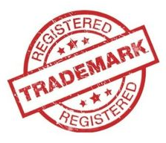

TRADEMARK
A symbol in the form of a logo, tagline, words, brand names, shapes, employed to provide the products or services with a recognizable identity is called as a Trademark.
Trademarks help in protecting the distinctive identification which make up the marketing identity of a brand.
Examples:
Brand names: Apple, Nike, Coca-Cola
Product names: iPhone, Air Jordan, Coke
Company logos: Golden Arches (McDonald's), Nike swoosh, Apple logo
Tagline: Just Do It (Nike), Think Different (Apple), I'm Lovin' It (McDonald’s)

Slide 16












IDENTIFY TRADEMARK LOGOS
Notes:
Nike
Dominos
Apple
Macdonals
Audi
Target

Slide 17

TRADEMARK TAGLINES

Slide 18


Slide 19
REQUIREMENTS FOR TRADEMARK REGISTRATION
The name, address and nationality of the applicant.
If the applicant is a company, the country or state of incorporation.
A list of goods and/or services for which registration is required.
Soft copy of the trademark to be registered.
If the mark contains or consists of non-English words, a translation of those words into English is required.
Priority Document : If the application is to claim priority from an earlier filed convention application.
Date of first use of the trademark in India, if at all used.
Power of attorney simply signed by the applicant.

Slide 20

GEOGRAPHICAL INDICATIONS
Geographical Indication (GI) is a tag or sign used on products for indicating their specific place of origin.
Provide protection for geographical indications (GIs) to prevent misleading use of indications that identify products as originating from a particular place.
Example:
Food (Tirupati Laddu, Dharwad Pedha)
Handcrafts (Kolhapuri Chappal, Mysore Silk, Kanchipuram Silk , Chennapatna Toys)
Industrial Products (Mysore Sandalwood Oil, Darjeeling Tea )
Agricultural products (Alphonso Mango, Nagpur oranges)

Slide 21

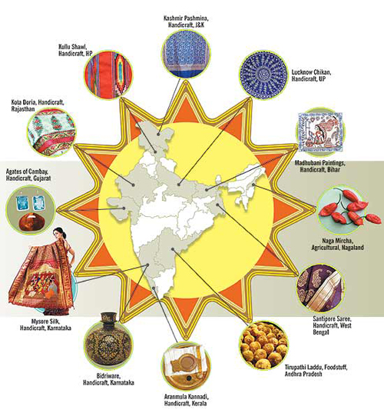

Slide 22
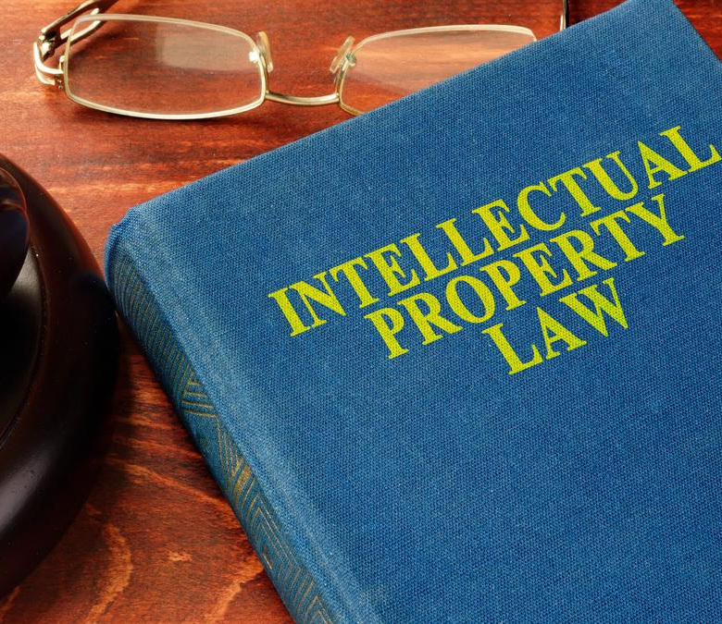
INTELLECTUAL PROPERTY SYSTEM
IN INDIA

Slide 23
The Copyright Act, 1957 Protects the rights of creators in original literary, artistic, and musical works.
Copyright protection is automatic and begins as soon as the work is created and fixed.
The Act provides protection for the lifetime of the author plus sixty years following their death.
The owner has the right to sell or license their rights to others (it can be transferred).
The Act allows fair dealing of the copyrighted work for private use, criticism, review, research, and reporting of current events.
If someone uses copyrighted content without the necessary permissions or beyond the scope of a license, the owner can take legal action against them (Penalties / other remedies as directed by law).

Slide 24
The Patents Act, 1970 Patents grant protection to certain new products, processes, apparatus, or any other technical inventions.
The Patents Act has been amended keeping in view the development of technological capability in India.
It integrates the intellectual property system with international practices.
The Patents Act, 1970, governs the grant and regulation of patents in India.
It has been amended in the year 1995, 1999, 2002 and 2005.
The Patent Amendment Act, 2005 is now fully in force and operative.
The Indian Patent Office is responsible for granting patents.

Slide 25
The Trade Marks Act, 1999 Governs the registration and protection of trademarks in India.
Distinctiveness: A trademark should be capable of distinguishing the goods or services of one trader from those of others.
Duration of Protection: Once registered, a trademark can be protected indefinitely, as long as renewal fees are paid as required by law.
Exclusive Rights: Trademark owners have exclusive rights to use their marks, thus preventing others from using similar marks.
Infringement: Trademark owners can take legal action against infringers.
Licensing: Trademark owners can license their marks to others.
Renewal and Maintenance: trademarks must be renewed every 10 years.

Slide 26
The Designs Act, 2000 Provides protection to industrial designs.
Definition of Design: The Act defines a design as the features of shape, configuration, or pattern.
Registration of Designs: Registration provides the owner exclusive rights to use the design.
Novelty and Originality: A design must be new and original, (should not be disclosed to public before filing date of application registration.)
Duration of Protection: Provides protection for a period of ten years, (extended for another five years, subject to payment of prescribed renewal fees.
International Recognition: Act helps in international recognition when design is registered.
Infringement: The owners can take legal action against infringers.

Slide 27
Goods Registration and Protection Act, 1999 Protects the geographical indications of goods and preventing unauthorized use of products associated with specific regions.
Protection of Rights: Provide legal protection to producers from a particular geographical area. It helps prevent misuse.
Economic Value: Enhance the economic value of products associated with specific geographical origins.
Cultural and Traditional Heritage: GIs reflect the cultural and traditional heritage of specific regions or communities.
Duration of Protection: GIs are protected indefinitely.
Promotion and Marketing: GIs can be used as valuable marketing tools to promote products associated with specific geographical origins.

